Slide 1
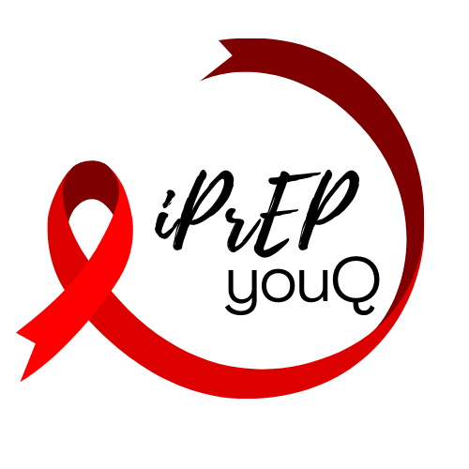
Barriers and Facilitators to PrEP use among young people under the age of 24
A systematic review of experiences towards access, uptake and use
Sarah Warzywoda (UQ), James A Fowler (UA), Amalie Dyda (UQ), Lisa Fitzgerald (UQ), Amy B Mullens (UniSQ), Judith A Dean (UQ)
Notes:
Since 2015 the WHO has recommended use of pre-exposure prophylaxis (PrEP) for all populations considered at substantial HIV risk, including young people. However, young people remain disproportionately affected by the HIV epidemic
This review aimed to explore the barriers and facilitators to PrEP access uptake in use in young people under the age of 24.

Slide 2
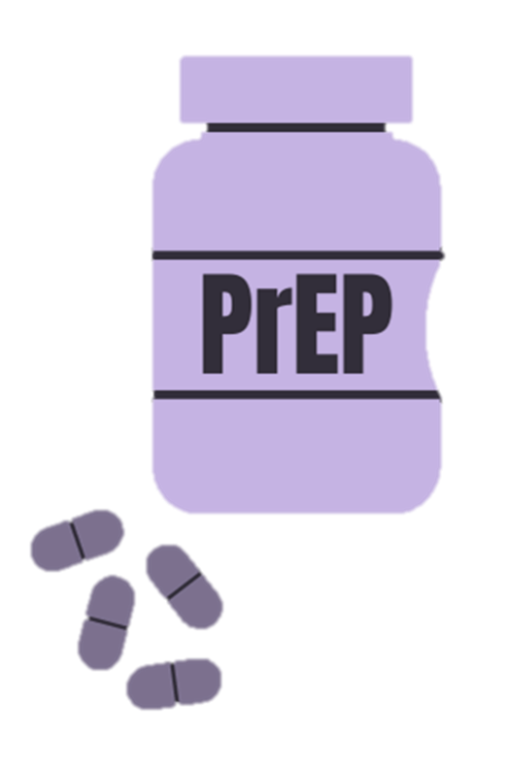
Findings
Stigma can prevent uptake but use results in personal agency
PrEP knowledge, attitudes, & risk perceptions
Attitudes & perceptions of family & society
Healthcare systems & healthcare provider (HCP) mistrust
Notes:
The findings of this review highlight that there are multiple factors that impact PrEP use across four broad areas. The individuals knowledge, attitudes and risk perception, how stigma can impact access but lead to personal agency, the attitudes and perceptions of family, and society, and how the healthcare system and healthcare providers can impact use.
There was a reported lack of awareness, knowledge and fear of side effects that was present among individuals as well as their family and partners and the community. This could result in the individual not seeking PrEP as well as negative reactions from parents and partners around sexual behaviours and PrEP use, that for some resulted in discouragement of use, confiscating pills or even physical violence. Conversely, families and partners who were supportive of PrEP use, acted as ‘cheerleaders’ through supporting adherence.
Stigma is a known barrier to accessing HIV prevention, and for young people, the fear of judgment from their social networks was a substantial barrier to use for fear of bullying, rumours about sexual behaviours or having HIV, and fear of being ostracised. However, some young people reported rejecting stigma. This was in the form of taking personal agency over their own sexual health, for some young women in Africa, this involved future plans for an education or family or protecting their current family and children. Community level education of PrEP was seen as a way to reduce stigma and normalise use and clinic attendance.
Lasty, the healthcare system was reported as a barrier for young people in accessing care. The financial implications for PrEP use, medication costs, healthcare appointments and travel to clinics was not maintainable for many young people, particularly for those financially dependent on parents and parental health insurance. For young people wanting to use PrEP independently of parents, this created concerns about confidentially due to parents seeing insurance claims, or fears that healthcare providers would disclose use to parents. Additionally, negative experiences from healthcare providers, including personal beliefs and judgements about behaviours and sexual orientations resulting in young people not wanting to seek healthcare or bring up PrEP to providers.

Slide 3
Key points
Improve awareness and knowledge of PrEP
Normalise use as a positive sexual health choice
Need to consider impact of family, partners, the community and the healthcare system PrEP uptake and use
Tailoring HIV and PrEP services will help increase equitable engagement
Notes:
These findings highlight that there are a number of factors that can impact PrEP access uptake and use in young people. In order to improve access to PrEP, there is a need to consider factors outside of the individual, including family, partners, the community and the healthcare system in HIV response. Incorporating these findings and the unique requirements of young people in tailoring HIV and PrEP services will help increase equitable engagement, reduce the disproportionate HIV burden experienced by young people and help achieve global targets working toward the elimination of HIV transmission by 2030.

