Slide 1
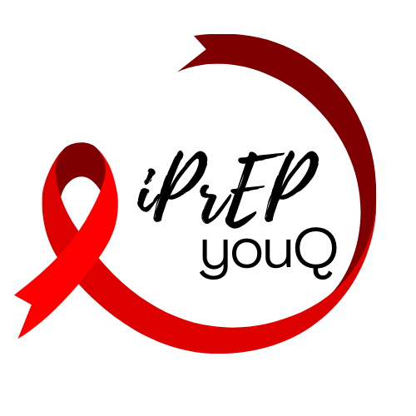
PrEP knowledge & HIV risk among Queensland university students
Sarah Warzywoda (UQ), Amalie Dyda (UQ), Lisa Fitzgerald (UQ), Amy B Mullens (UniSQ), Judith A Dean (UQ) and the TSSRHS Consortium (UQ, UniSQ, QUT, UniSC, Griffith)
Notes:
As young adults enter university life their sexual health related risks change with their changing patterns of behaviours (including increases in sexual partners and reductions in condom usage). This study investigated the HIV knowledge, risk and PrEP awareness among Queensland University students.
Using data from the 2019 Tertiary Students Sexual and Reproductive Health Survey, descriptive analysis was conducted to investigate HIV knowledge and risk and univariate, and multivariate analysis were conducted to investigate potential associations of key variables with PrEP.

Slide 2
Results: HIV knowledge and Risk
HIV knowledge scores (range 0-12)
Mean knowledge score = 9.8 (82%)
‘You can take a pill every day to prevent getting infected with HIV’
20.5% correctly answered
HIV Risk scores
↑ MSM
↑ older age
↑ International students
↑ No Medicare
↑ Awareness of PrEP
 | All MSM* (N=207) | All other sexual behaviours** (N=4,084)
Mean HIV risk score | 6.2 | 3.2
Range 0-37
Mean HIV risk score by age
18-19 years | 3.2 | 2.6
20-24 years | 6.8 | 3.3
25-29 years | 8.0 | 3.6
30-34 years | 6.0 | 4.0
35-39 years | 11.5 | 4.3
40 years and over | 7.8 | 3.6
Mean HIV risk score by student status
Domestic Australian born | 5.9 | 3.4
Domestic Overseas born | 6.3 | 3.3
International | 7.0 | 2.4
Mean HIV risk score by Medicare status
No Medicare access | 7.1 | 2.4
Medicare access | 6.0 | 3.4
Mean HIV risk score by PrEP awareness
Not aware of PrEP | 3.9 | 3.5
Aware of PrEP | 7.0 | 4.3
Notes:
HIV knowledge scores ranged from 0-12, with an average score of 9.8/12. The mean score is similar to that found in the 6th National survey of Australian secondary students and sexual health. Our study however asked an additional statement to the 6th national survey: ‘You can take a pill every day to prevent getting infected with HIV’ This statement related to knowledge about Pre-exposure prophylaxis, returned the lowest correct response (20.46%), indicating an overall low knowledge of PrEP.
HIV risk scores ranged from 0-37/41, with 73.64% of the total sample meeting at least 1 risk criteria. Higher mean risk scores were observed among men who have sex with men (MSM) (6.2) compared to all other sexual behaviours (3.2) across all the categories investigated. More specifically among MSM higher risk scores were noted among those of older age, international students, participants that reported lack of Medicare access, as well as those self-reporting awareness of HIV pre-exposure prophylaxis.

Slide 3
Results: Adjusted odds ratios
PrEP Awareness |  | aOR | p-value
Age (median age 21; IQR=19-25) | 18-19 years | Ref
 | 20-24 years | 2.68 | 0.00
 | 25-29 years | 2.65 | 0.00
 | 30-34 years | 2.86 | 0.00
 | 35-39 years | 1.98 | 0.02
 | over 40 years | 1.17 | 0.63
Gender Identity | Man | Ref
 | Woman | 1.48 | 0.05
 | Non-binary, gender diverse | 8.54 | 0.00
 | Different identity | 1.00 | (empty)
Student Enrolment | Domestic (Australian born) | Ref
 | Domestic (Overseas born) | 0.84 | 0.25
 | International | 0.64 | 0.01
Sexual behaviour | Men who have sex with women | Ref
 | Men who have sex with men | 73.25 | 0.00
 | Men who have sex with men and women | 11.11 | 0.00
 | Men unsure | 3.46 | 0.00
 | Women who have sex with men | 0.62 | 0.00
 | Women who have sex with women | 3.89 | 0.00
 | Women who have sex with men and women | 1.13 | 0.49
 | Women unsure | 1.00 | (omitted)
 | Unsure | 1.00 | (omitted)
HIV prevalence in country of origin | HIV prevalence <1% | Ref
 | HIV prevalence >1% | 1.32 | 0.47
Ever had HIV test | No | Ref
 | Yes | 2.28 | 0.00
 | Unsure | 0.92 | 0.63
Likelihood of PrEP awareness:
↑ increasing age (p<0.05)
↑ non-binary/gender diverse (p<0.05)
↑ MSM, MSMW and WSW (p<0.05)
↑ ever test for HIV (p<0.05)
↓ International students (p=0.25)
Notes:
Factors significantly associated with PrEP awareness included identifying as men who have sex with men, non-binary/gender-diverse, having previous HIV testing. Condom usage and older age (>20 years) were also associated with increased awareness of PrEP. From these results higher awareness among MSMS is not unexpected as HIV prevention is primarily targeted towards this group. However there remains an age-related disparity in awareness. Additionally there was found to be lower likelihood of awareness among international students.
This study highlights that while subsets of young people are aware of PrEP and PEP, many eligible young people are not accessing these prevention options despite government subsided access now available in Australia. Increased HIV risk among MSM, older students and those with no Medicare access represents opportunities for targeted health promotion. Targeted age appropriate health promotion opportunities aimed at increasing uptake among this younger populations are needed. Addressing our identified gaps in understanding will improve the sexual health outcomes for young Australians at risk of HIV and contribute to reducing the resulting health and economic burdens of life-long HIV infection.

Slide 4
Significance
Improve the sexual health outcomes for young Australians at risk of HIV
Improve equitable access for Medicare ineligible and those at increased risk of HIV
Australia’s goal of ending HIV transmission by 2025
Notes:
This study highlights that while subsets of young people are aware of PrEP and PEP, many eligible young people are not accessing these prevention options despite government subsided access now available in Australia. Increased HIV risk among MSM, older students and those with no Medicare access represents opportunities for targeted health promotion. Targeted age appropriate health promotion opportunities aimed at increasing uptake among this younger populations are needed. Addressing our identified gaps in understanding will improve the sexual health outcomes for young Australians at risk of HIV and contribute to reducing the resulting health and economic burdens of life-long HIV infection.

